Slide 1
The Context of Psychosocial Intervention Development: Where Do We Go From Here?
Brandon A. Gaudiano, Ph.D.
Warren Alpert Medical School of Brown University
Butler Hospital
Providence, Rhode Island

Slide 2
Current staged model of treatment development favored by the National Institutes of Health…
Stage I: Development and Pilot Testing
Ia: Manual Development
Ib: Open Trial
Ic: Pilot Randomized Trial
Stage III: Effectiveness Trial (“real world” testing), Implementation, and Dissemination
Stage II: Full-Scale Randomized Trial (Efficacy)

Slide 3
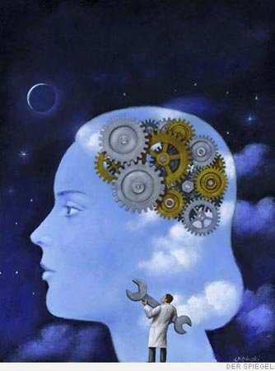
Limitations of the Current Model
Linear and inflexible
Based on biomedical and psychiatric worldviews
Adapted from drug development methodology
Focused on DSM syndromes
Emphasis on symptom reduction
Lack of integration with basic science

Slide 4
What We Need for a Psychosocial- Focused Approach
Empirically-supported principles of behavior change (versus empirically-supported therapy packages)
An understanding of psychosocial mechanisms underlying the development and maintenance of intervention targets (i.e., basic research)

Slide 5
What We Need for a Psychosocial- Focused Approach
Wider definition of what an “intervention” is (e.g., paraprofessional led interventions, self-help, peer support, community prevention, and new technologies)
Intervention targets best suited to psychosocial interventions (e.g., functioning, quality of life, new skill acquisition, subjective well-being)

Slide 6
What We Need for a Psychosocial- Focused Approach
Attention to multiple factors that affect the impact of interventions throughout the development process: basic science, feasibility, acceptability, efficacy, effectiveness, implementation, dissemination
Multiple pathways to development that provide more flexible approach appropriate to the scientific question (in contrast to one-size-fits-all approach)

Slide 7
Outpatient Treatment Use at Mental Care Facilities
Treatment | 1998, % | 2007, % | AOR (95% CI)
Psychotherapy only | 15.9 | 10.5 | 0.66 (0.48 – 0.90)
Both together | 40.0 | 32.1 | 0.73 (0.59 – 0.90)
Psychotropics only | 44.1 | 57.4 | 1.63 (1.32 – 2.00)
“National Trends in Outpatient Psychotherapy”
Mark Olfson, M.D., M.P.H. & Steven C. Marcus, Ph.D.
Am J Psychiatry 2010;167:1456-1463.

Slide 8
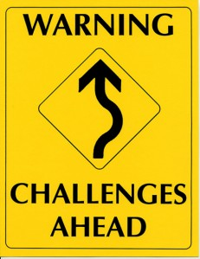
Why You Should Care…
Increasingly, money and resources are going to studies of biological treatments vs psychosocial ones (i.e., NIH and Big Pharma)
More evidence will be accumulating in the years to come for non-psychosocial treatments
The increasing evidence that will be generated in support of non-psychosocial treatments will be used to dictate evidence-based treatment guidelines and what insurance companies pay for
Psychosocial treatment use will continue to decline…

